Slide 1


Workshop on evaluating vaccine impact Evaluating Vaccine Impact using Time Series Data
Dan Weinberger, PhD
Epidemiology of Microbial Diseases
Yale School of Public Health

Slide 2
How much does the rate of cases or deaths decline following vaccine introduction?

Slide 3
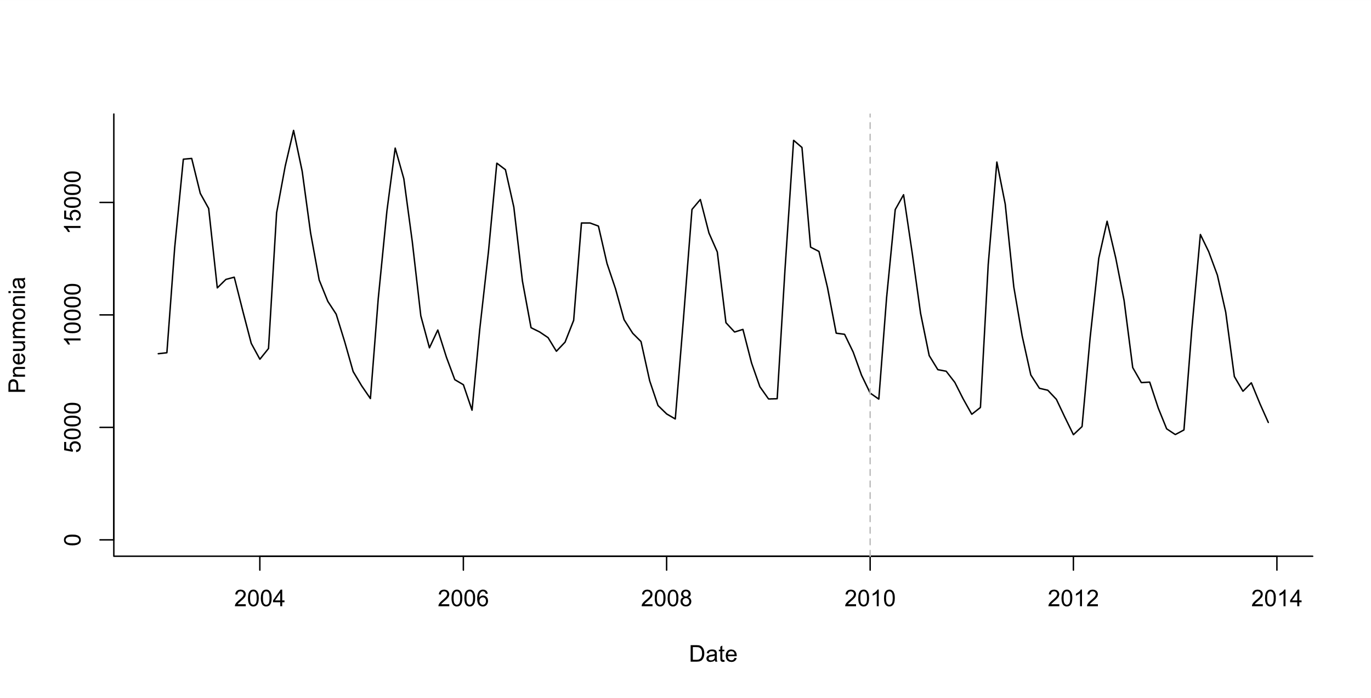
Estimating the effect of vaccine
Vaccine intro
“Counterfactual”
Vaccine effect
Pre-vaccine
Post-vaccine

Slide 4
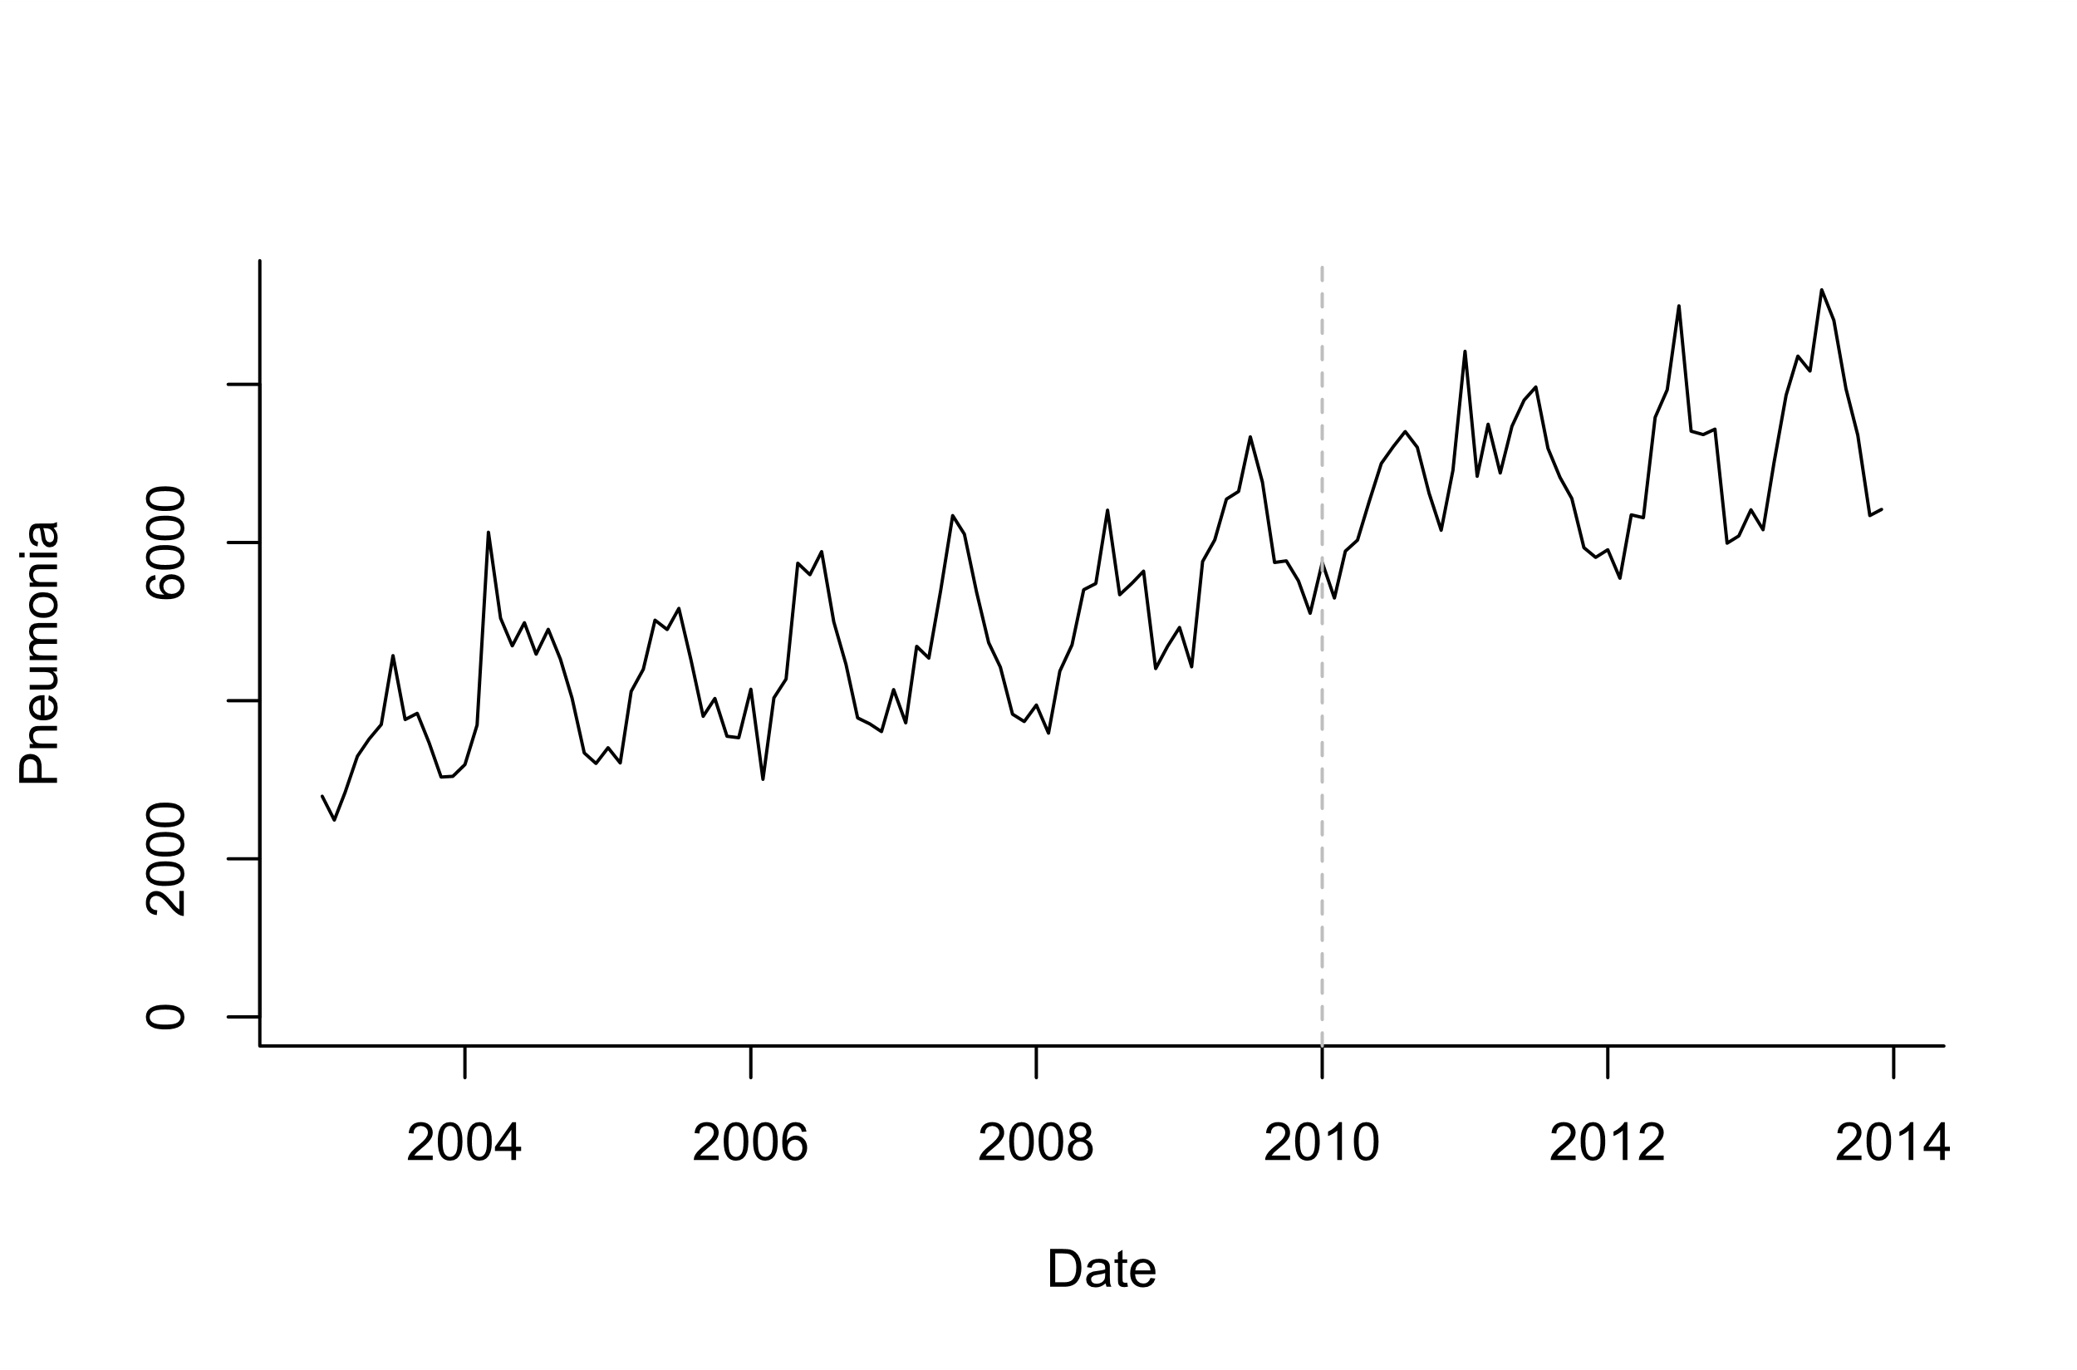
Estimating the effect of vaccine
?
Vaccine effect?
Pre-vaccine
Post-vaccine

Slide 5
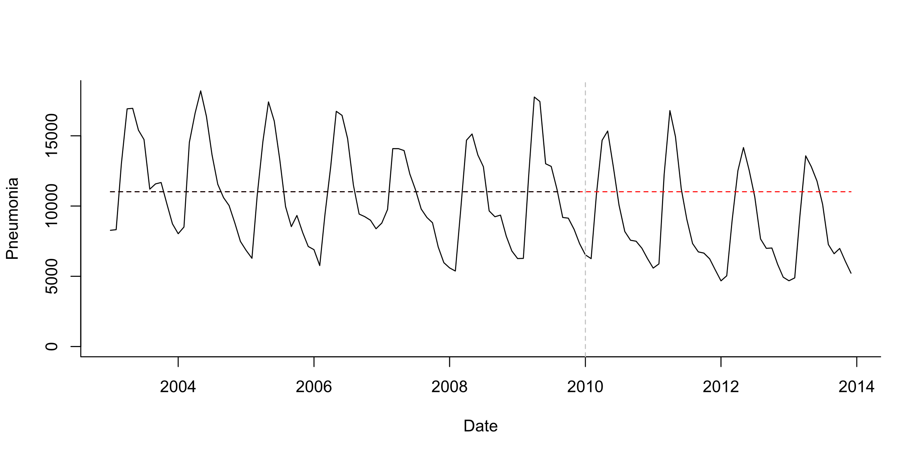
Pre-post analysis
Simple model:
Log(Pneumonia)=b0
Simplest case: stationary data ; no trends, no seasonality
Test whether mean number of cases declines post-PCV

Slide 6
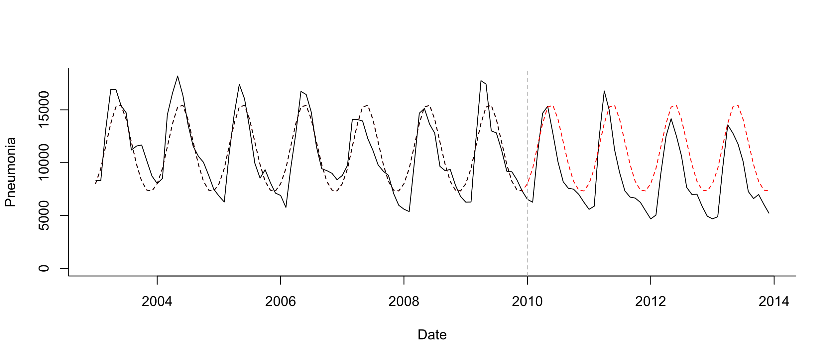
Pre-post analysis+seasonality
Seasonal model:
Log(Pneumonia)=b0 +b1*sin12 +b2*cos12
Test whether mean number of cases declines post-PCV

Slide 7
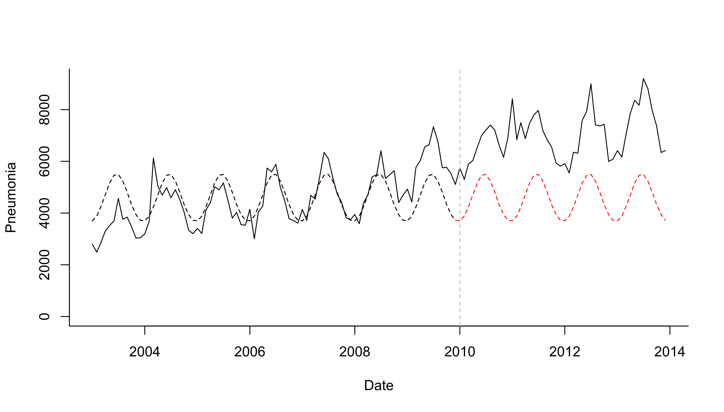
Pre-post analysis+seasonality
Seasonal model:
Log(Pneumonia)=b0 +b1*sin12 +b2*cos12
Test whether mean number of cases declines post-PCV

Slide 8
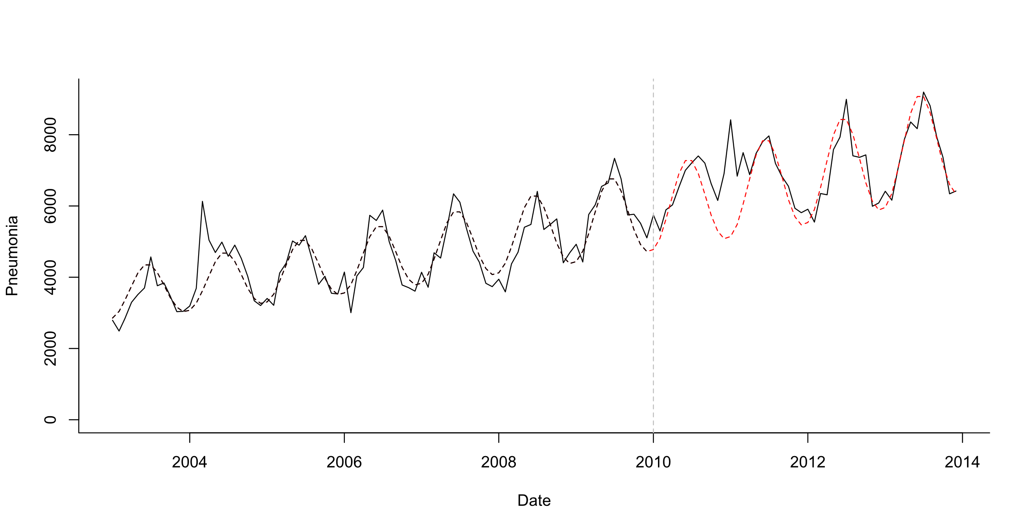
Pre-post analysis+seasonality + linear trend
Test whether mean number of cases declines post-PCV
Seasonal model:
Log(Pneumonia)=b0 +b1*sin12 +b2*cos12 +b3*trend
What is your evaluation period?
Last 2 years? Last 3 years?

Slide 9
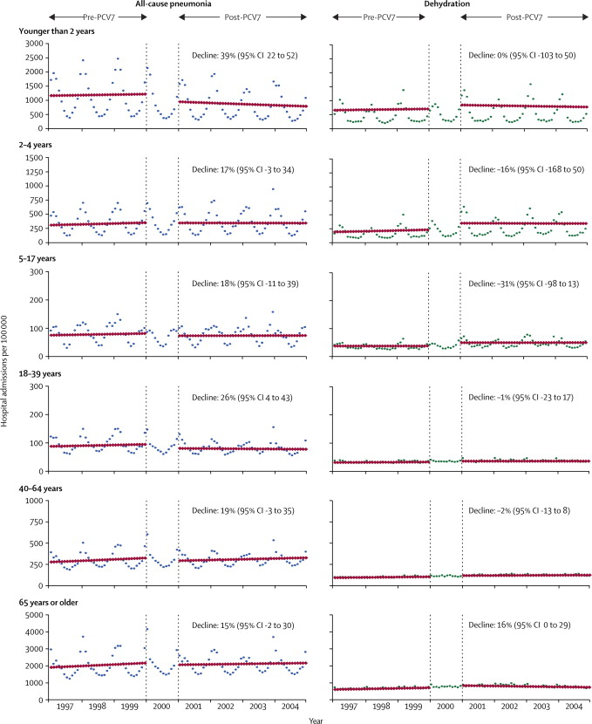
Evaluating impact of vaccines from time series
Counterfactual
Grijalva et al, The Lancet 2006
Pneumonia declines 39% compared to what would have been expected if not vaccine was introduced

Slide 10
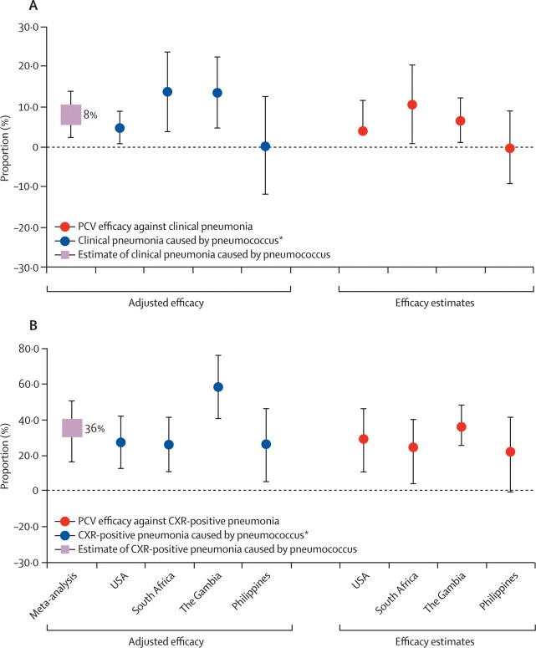
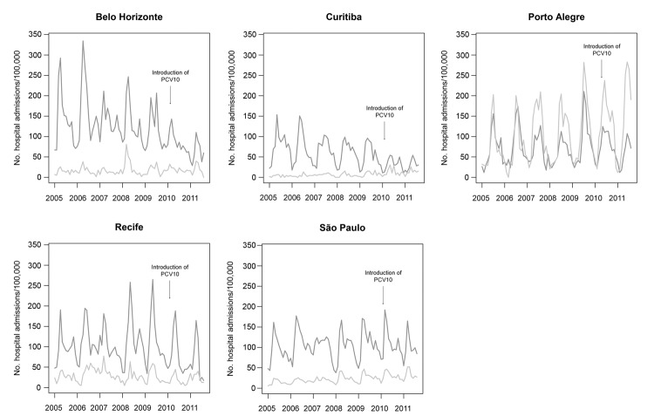
Why should you be skeptical of these types of analyses?
How much can the changes in all-cause pneumonia be attributed to PCV?
Trend studies: Variability; up to 40% declines
RCTs: ~8% Efficacy
Grijalva, The Lancet 2007
(Brazil)
2-23 month olds
-40.3%
Afonso, 2013 EID
O’Brien et al, The Lancet

Slide 11
Testing for a change in trend: Interrupted time series (ITS)
Does slope significantly change at time q
Predicted value at time t: Yt=exp(b+ a*t + c*z + d*t*z)
Counterfactual at time t: Yt=exp(b+a*t)
Difference or ratio between observed and counterfactual lines gives the “Vaccine impact” (rate ratio or rate difference)

Slide 12
Steps for evaluating change in trend
Define “baseline”, transition periods
Determine whether there are any trends or patterns in the baseline period
Seasonality, etc
Fit a model to your baseline data using regression
Be wary of over-fitting (use AIC)
Compare test and reference periods
THINK ABOUT WHAT COULD GO WRONG:
Identify controls!
Do sensitivity analyses!
i.e., leave out one season at a time; try different intervention times

Slide 13
Sensitivity analyses you should consider
Never trust your main analyses without “pressure testing” it
Try different intervention dates—how does it influence your estimate?
Leaving out different seasons when fitting, see if it changes the answer
Perform simulations to see how likely it is that you would detect a decline
https://weinbergerlab.shinyapps.io/ITS_Poisson_Power/

Slide 14
How much data do you need for a trend analysis?

Slide 15
Ability to detect a vaccine-associated decline
Depends on:
Size of the expected decline (ie a 40% decline is easier to see than a 10% decline)
Amount of unexplained variability in the data

Slide 16
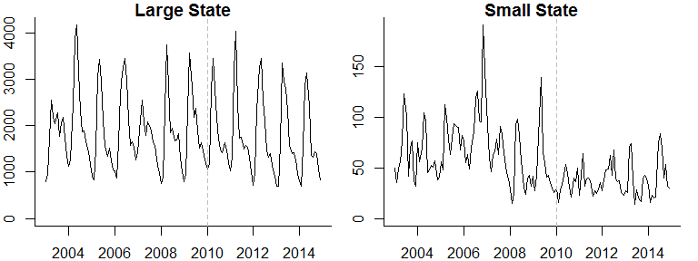
Pneumonia hospitalizations (N)

Slide 17
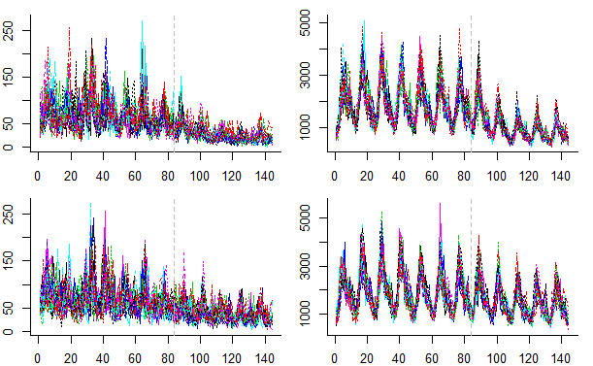
Simulated time series for a large and small state
20 Simulated time series for a small state
20 Simulated time series for a large state
50% reduction
20% reduction
https://weinbergerlab.shinyapps.io/ITS_Poisson_Power/

Slide 18
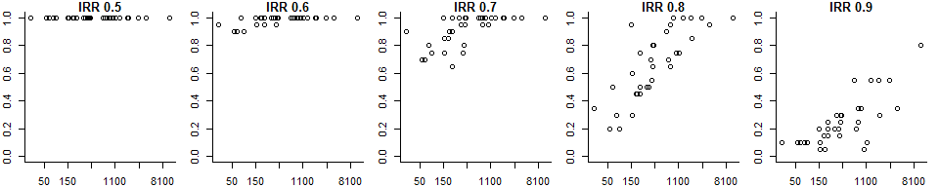
Power to detect a vaccine effect
Each dot on the plots below represents 1 of the 27 states
Each plot represents a different expected vaccine effect
Power: Percent of the simulations for which 95% CI for the rate ratio does not include 1
Expected vaccine effect (IRR)
Power
Average cases/month pre-PCV
With a smaller vaccine effect, only large states have adequate power
With a strong vaccine effect, even small states have excellent power to correctly detect the effect
All-cause pneumonia studies somewhere around here

Slide 19
Summary so far
Interrupted time series use linear trends to adjust for factors unrelated to vaccinations and to measure changes in the frequency of disease that occurs after vaccine introduction
The accuracy of these estimates and ability to measure it depends on the expected size of the decline and the amount of unexplained variation (noise) in the data
Typically have more noise in datasets from smaller populations

Slide 20
What else could go wrong with analyses?
Epidemic before or after vaccine introduction (biases slope estimates)
Ie 2009 pandemic, then introduce PCV in 2010
Insufficient data in pre- or post-period to accurately estimate trend
Unrelated changes that coincide with vaccine introduction
Delayed rollout of vaccine/low uptake
Many, many other issues that you can’t predict…

Slide 21
Up next: live sessions
1) Introduction to interrupted time series methods in R
2) Case study on evaluating the impact of PCVs in The Gambia, using R

